Slide 1

CA22123 EU-MACE: Core Group monthly update GP2 #6
Virtual
09/06/2025

Slide 2
meeting Agenda
Recording in progress

Slide 3
FutureLabsLive 2025
What we did
Impact?
Conference and STSM Grants – update
EUROMAT2025 (ITC, YRI & DCG)
STSM via LegacyLabs
Euromat2025 – preparation
Invited speakers
Afternoon sesson
LegacyLabs
Projects calls: EIC, MCSA, INFRA, HEU-CL4, CL5
Young EU-MACE webinar n°1: Tomasz Stasiak (WG2 member, NCBJ, Poland)

Slide 4
Recap from Future Labs Live 2025

Slide 5

Future Labs Live 2025 – Basel
27-28 May, 2025
terrapin.com/conference/future-labs-live/index.stm (see previous meeting presentation for more information)
Exhibition Booth & Seminar session (30 minutes):
Booth: EU-MACE and our member labs! Brochures, Demos, videos
Session: Building MAP ecosystem – Saco, Gloria and Ozlem
Connecting MAPs
Role of sci. Communications
Legacy lab project
FZJ (Kourosh), Franhofer (Simon), Ozlem (BAM) also speaking in various sessions
EU-MACE funding: Booth space & DC grants for Action Chair and Communications coord.
New WG applications received
3 SMEs
2 consortiums (1 waiting)
Several individual researchers

Slide 6
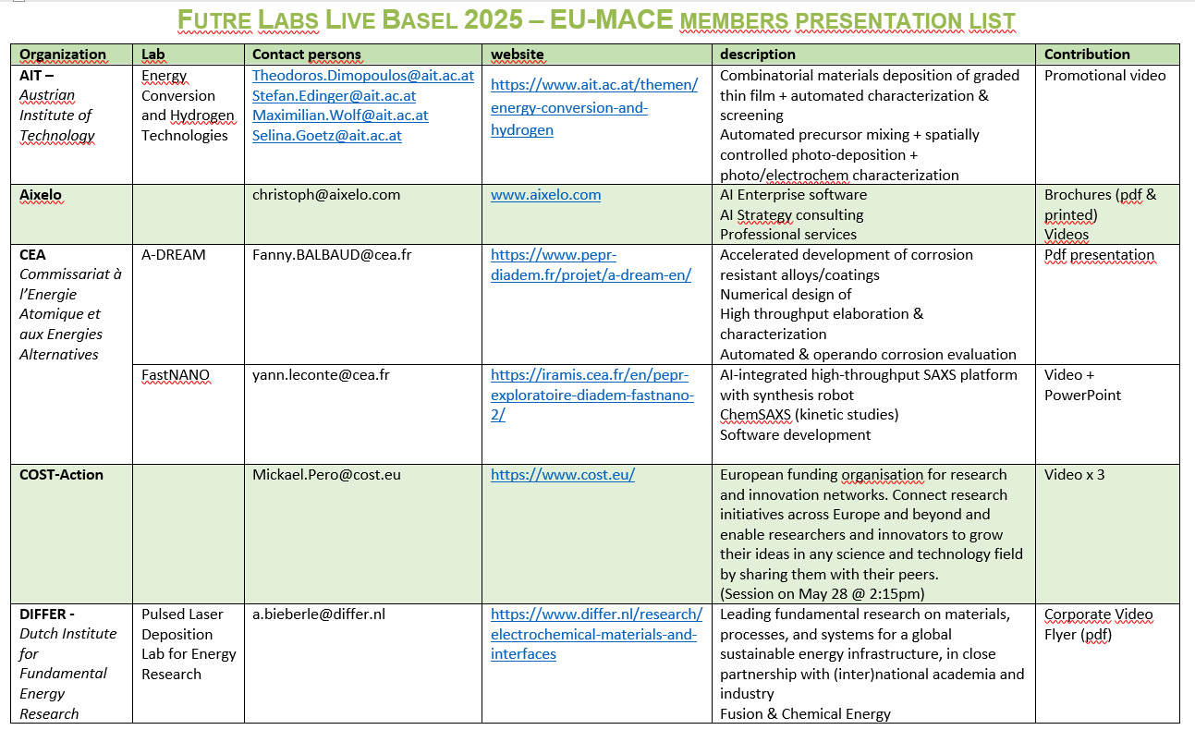

Slide 7
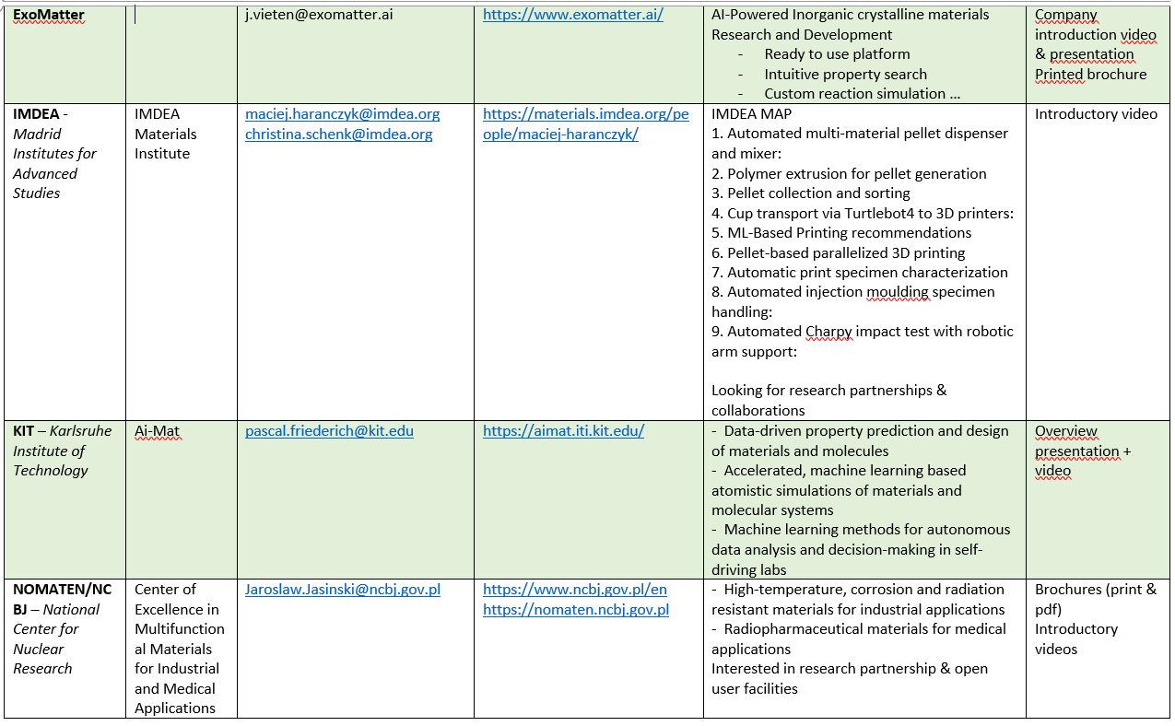

Slide 8
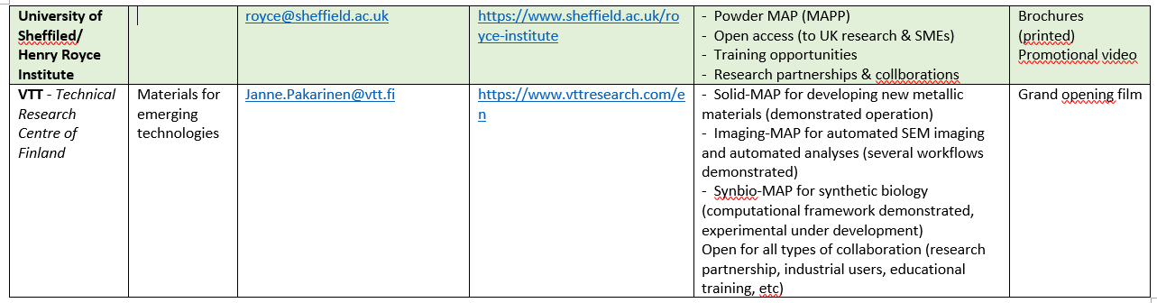
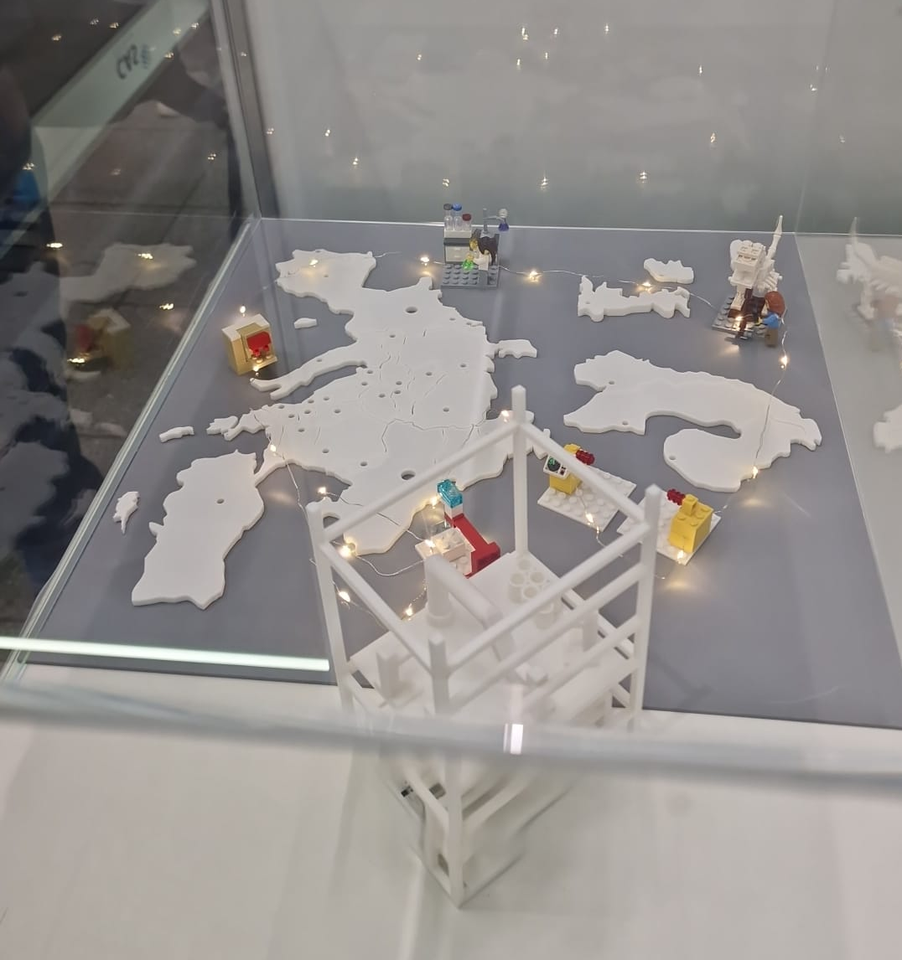
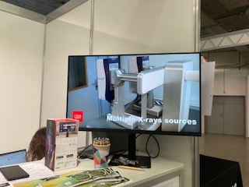
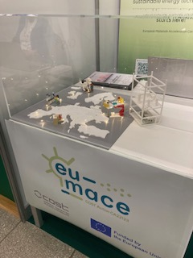
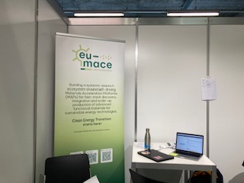

Slide 9
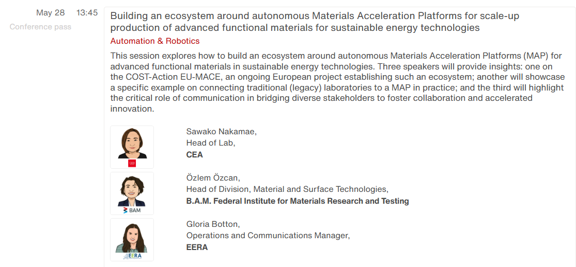
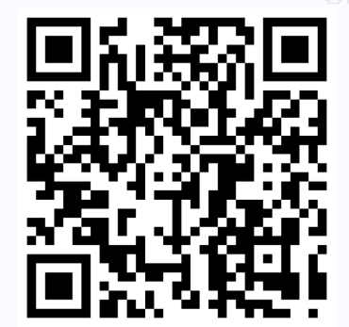
Future Labs Live – Our session
So far, we have received 7 replies only!!!

Slide 10
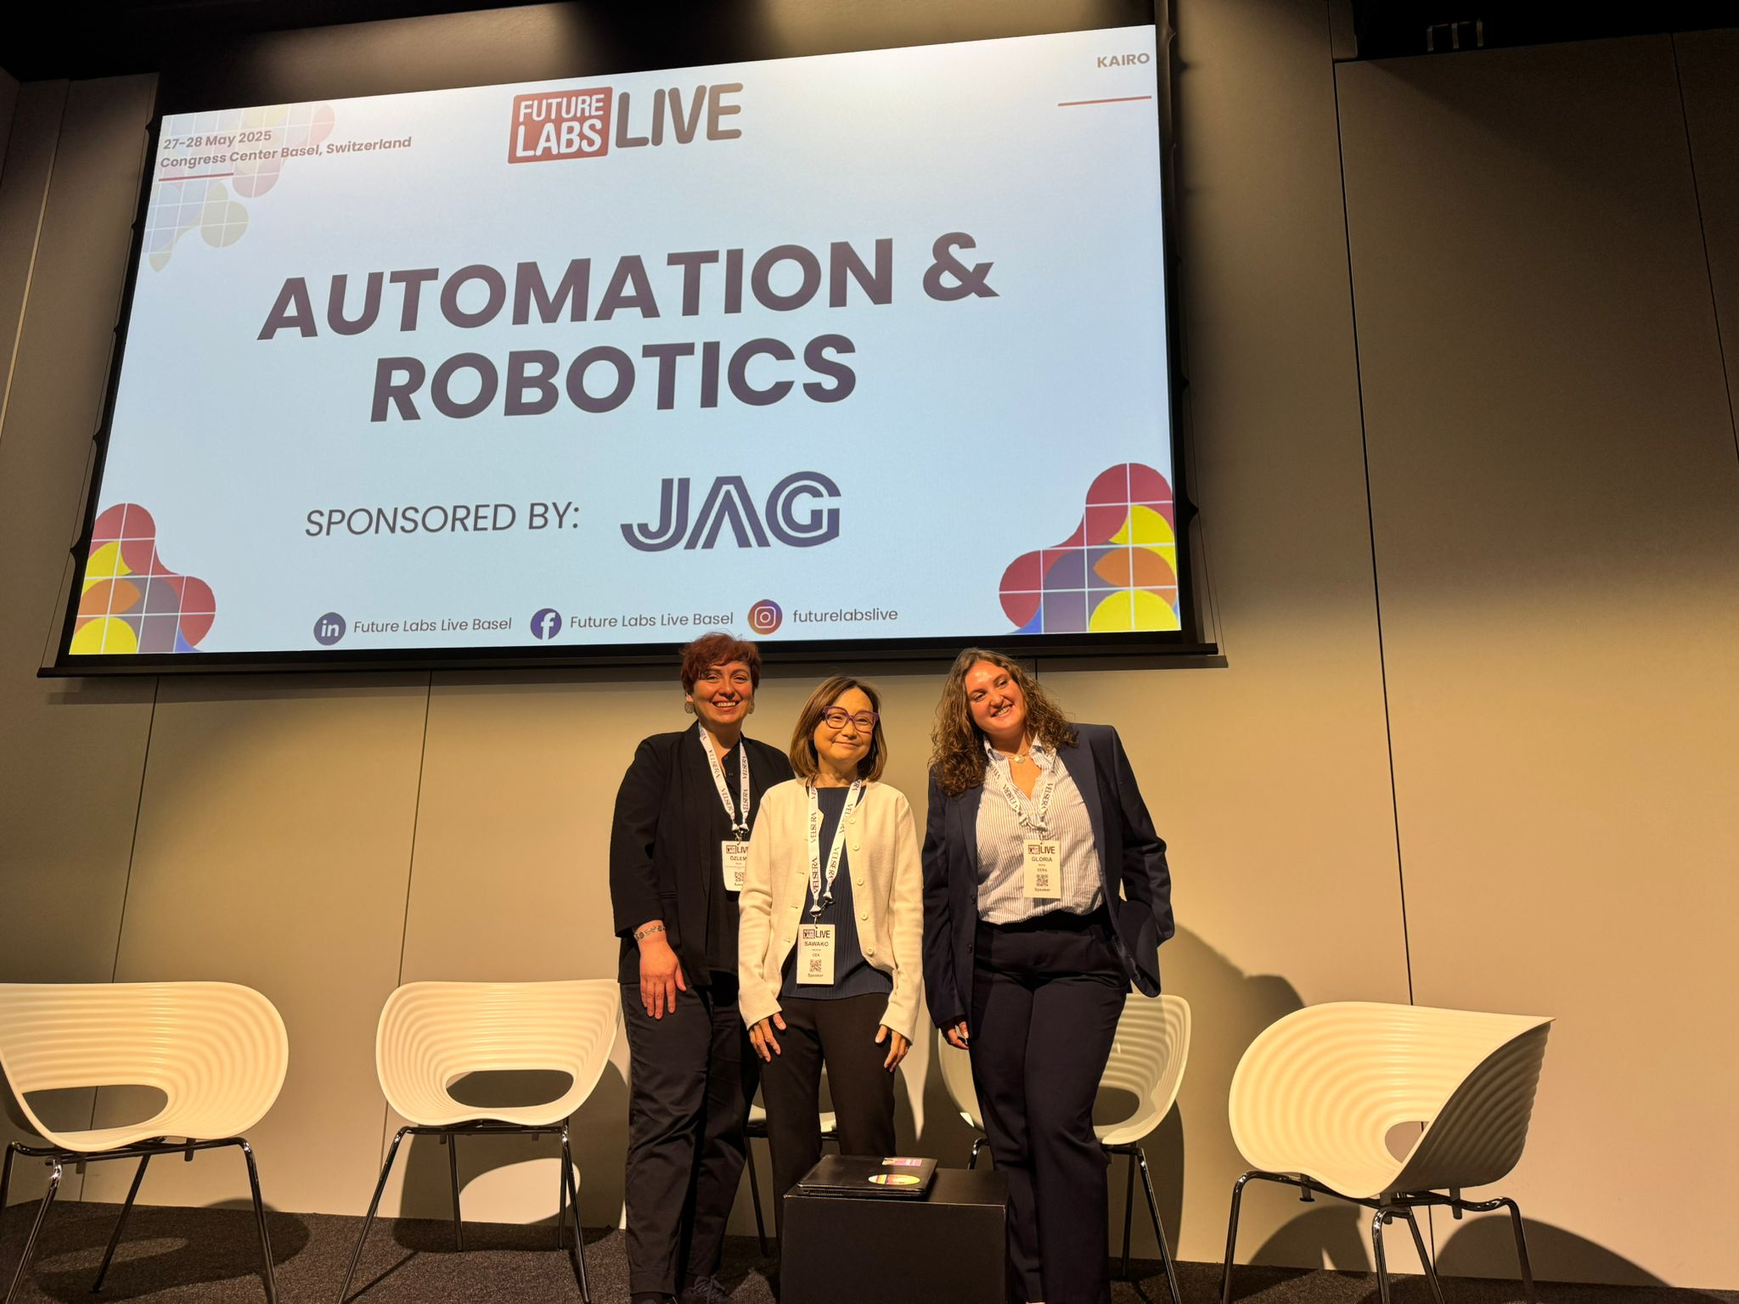
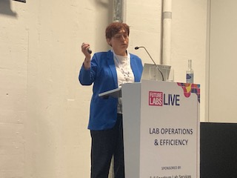
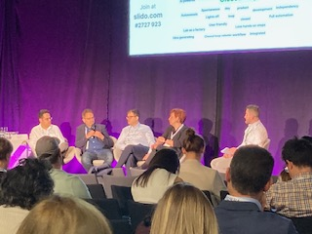
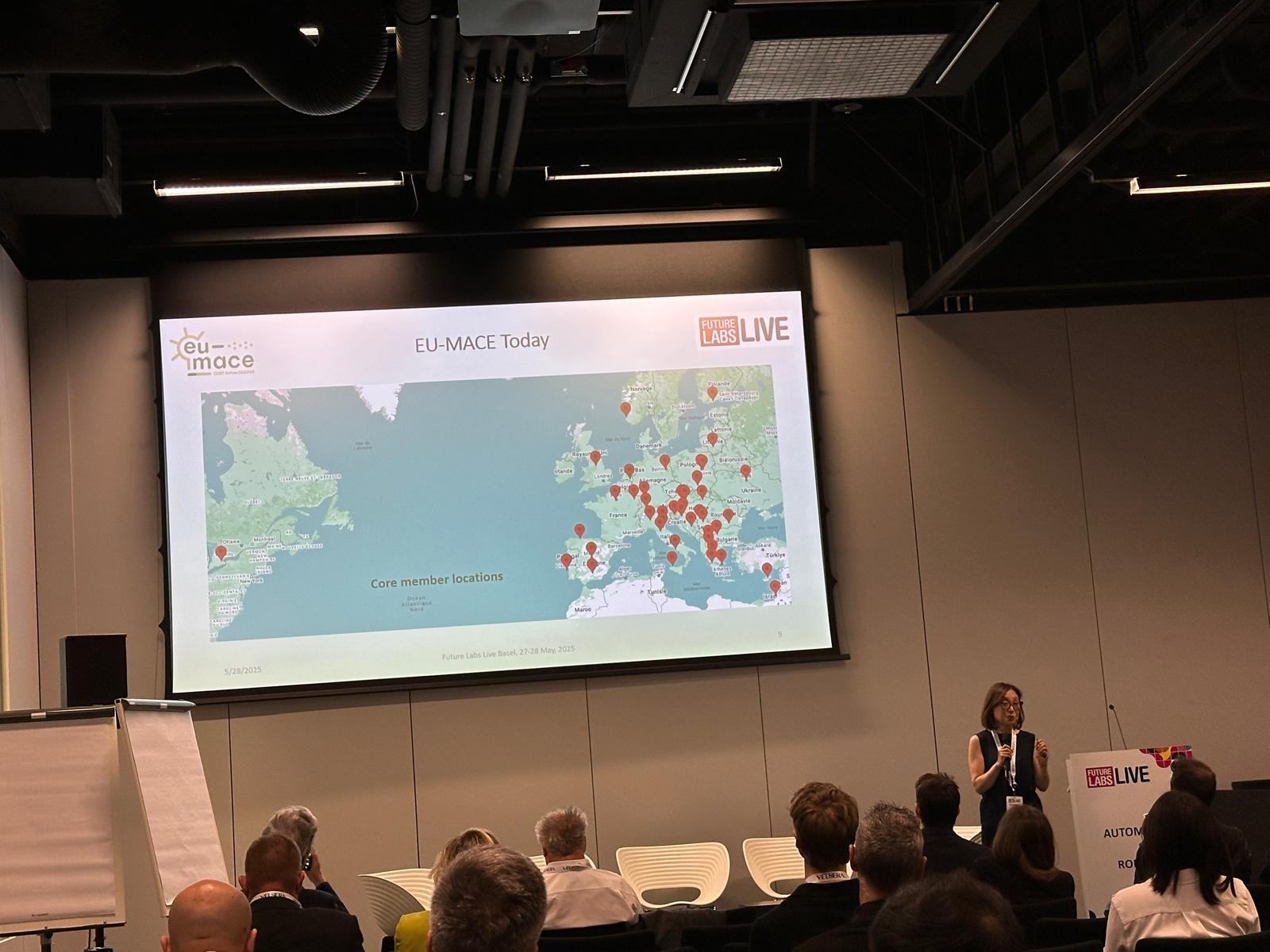
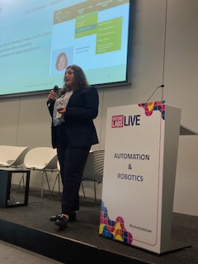
… @Conference
Automation !
Robotics !
Lab Operations !
Efficiency !

Slide 11
EUROMAT 2025

Slide 12
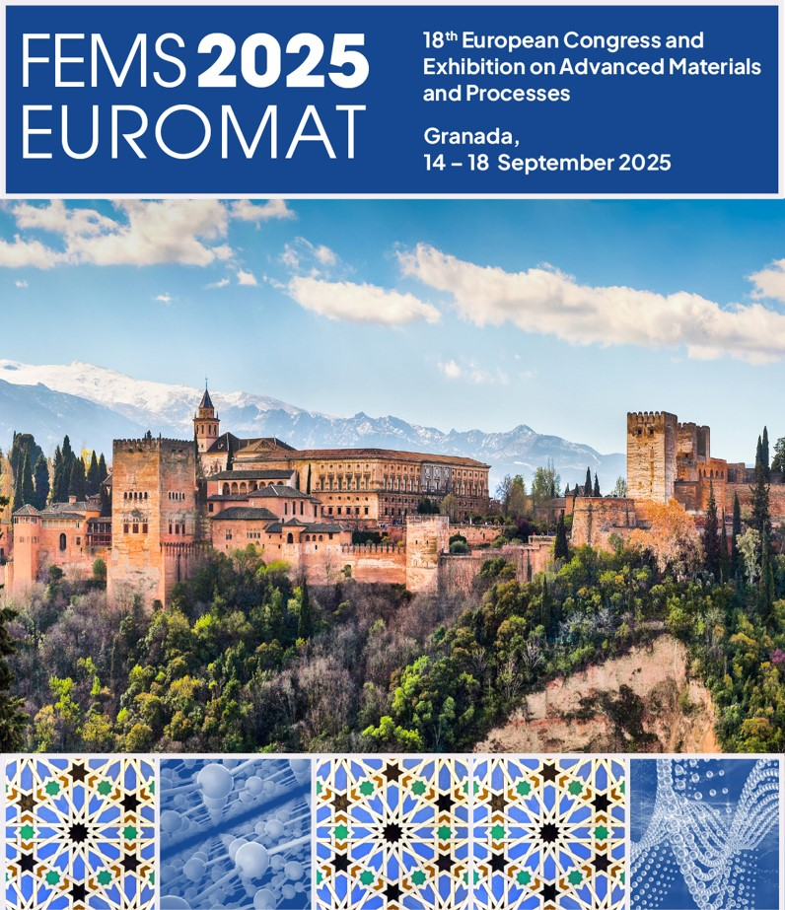
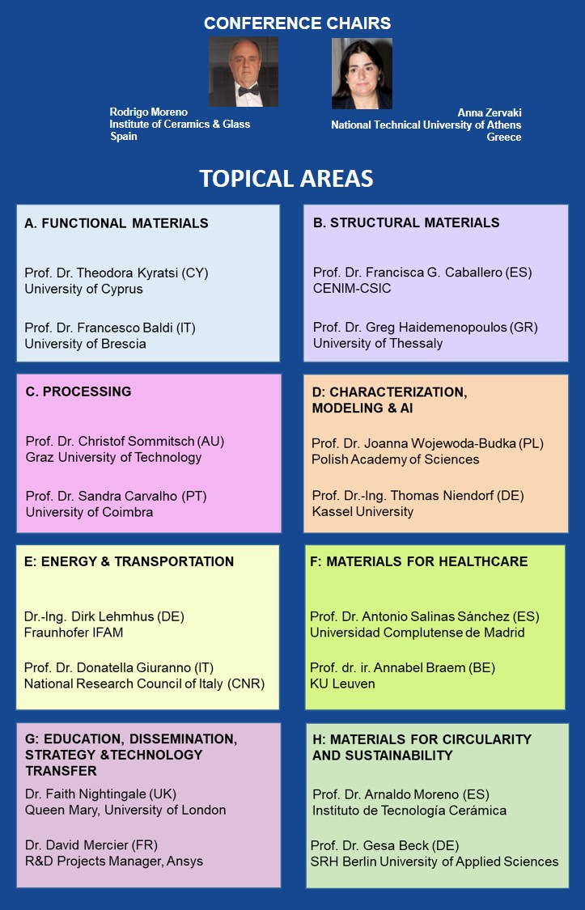


Notes:
12

Slide 13
Accelerated device integration
Description:
This public session of the Forum, held as an associated event of FEMS EUROMAT 2025,
focuses on the integration of advanced materials into next-generation energy devices, with a particular
emphasis on batteries and thermoelectric modules. It brings together stakeholders from three key sectors—
Industry (SMEs), Materials Acceleration Platforms (MAPs), and conventional academic research laboratories—
each operating with distinct scientific goals, methodologies, and technological constraints.
Through presentations followed by a round table discussion, the session will explore how these sectors
approach device development, the major challenges they encounter, and how we establish collaborative
frameworks by leveraging complementary strengths and building a technology pipeline for enabling more
efficient and accelerated development of energy solutions.
Attendance is free but requires prior registration due to limited seating.
To be announced on EU-MACE webiste, LINK to be created on Euromat website this week!

Slide 14
Invited Speakers:
From SME:
Dr. Eleni-Chrysanthi Stefanaki (Research Scientist) R&D Department, European Thermodynamics Limited (UK)
Title: Bridging Innovation and Application: From Advanced Materials to Scalable Product Design
Dr. Matteo Alberghini , PhD (Multi-physics modelling Eengineer), Gemmate Technologies (IT)
Title: Enabling the design and integration of advanced energy materials: an innovative battery pack case study
From MAP:
Bojing Zhang (PhD candidate) Munich Institute for Robotic and Machine Intelligence, TUM (DE)
Title: TBA – high throughput production of coin-cell batteries via MAP
Dr. Maciej Haranczyk & Dr. Chirstina Schenk, IMDEA Materials Institute (SP)
Title: TBA – additive manufacturing of battery packs/new MAP project for thermoelectric modules
From conventional lab:
Dr. Panagiotis Ioannou, University of Cyprus (CY)
Title: TBA – thermoelectric modules
Dr. Vitto XXXX? University of Padova – to be confirmed!
Title: TBA – solid Li or Na battery prototypes

Slide 15
Afternoon : EU-MACE session (Legacy Lab & WG3)
Legacy labs: The session aims to explore the possibilities for the integration of conventional research laboratories into Materials Acceleration Platforms (MAPs) using intelligent workflows and establishment of data pipelines. Discussions will address current challenges, exchange best practices, and identify collaborative opportunities to enhance the adoption of advanced digital methodologies, promoting efficient, innovative, and sustainable materials science. Legacy-lab partnerships will present their collab progress
TDM: We will also present novel technology management concepts to identify R&D gaps in new materials development that could potentially addressed by modern self-driving lab or combination of self-driving and legacy labs. With a top-down approach in mind (market and application attributes to materials properties and integration readiness) a technology development matrix (TDM) was developed to identify the market opportunities of three new material classes across 6 use cases. TDM is a form of technology management framework that can help technologists identify the technical R&D gaps and target suitable market opportunities for adopting the new technologies. As an integral part of WG3, we report on status of the TDM, gathered data and open technical reports to disseminate as part of WG3 output.

Slide 16
EUROMAT 2025
Organization, etc.
Org. Comm. from EU-MACE
Theodora Kyratsi
Antonio P Sanjuan (local org.)
Jaroslaw Jasinksi
Monica Fabrizio
Holger Ihssen
Sawako Nakamae
+ Legacy Lab & TDM team
Ozlem
Sandra
Kourosh
Dorottya
50 attendees (in-person) + 30 (online)
Invited attendees, CG recipients and public
September 14, 2025 – full day
Registration is independent from EUROMAT: Link to appear this week?
Total 20-25 attendees possible
7 invited speakers
Legacy-labs - 8
TDM (WG3) – 8
Special provision for 8 YRI’s + ITC conference grants (max 1800€ each) so far given ➔ 2 more possible

Slide 17
Conference and STSM grants

Slide 18
2nd Grant Period – Grant award so far
Conference grants (15) : MANY applications (close to 50% are rejected)
EUROMAT 2025 (must also attend the EU-MACE Forum) ➔ 8 (ITC & YRI)
Future Labs Live conference ➔ 2 Dissemination CG
Non-priority conferences ➔ 3 YRIs
http://iwpdf.metu.edu.tr/ (fracture & damaging) Session on “materials data” Abstract deadline May 1: anyone?
European Thermoelectric Conference: September (abstract submission is now open): anyone?
EMRS-Fall meeting – recommended by COST Action officer: anyone?
Only 2 more possible (max changed from 2000€ to 2500€ this year)
STSM (5-6): (1 submission has been rejected)
Legacy Labs ➔ finalization on June 24th
https://www.european-mrs.com/artificial-intelligence-accelerate-development-new-advanced-materials-energy-emrs

Slide 19
Update legacy lab & tdm

Slide 20
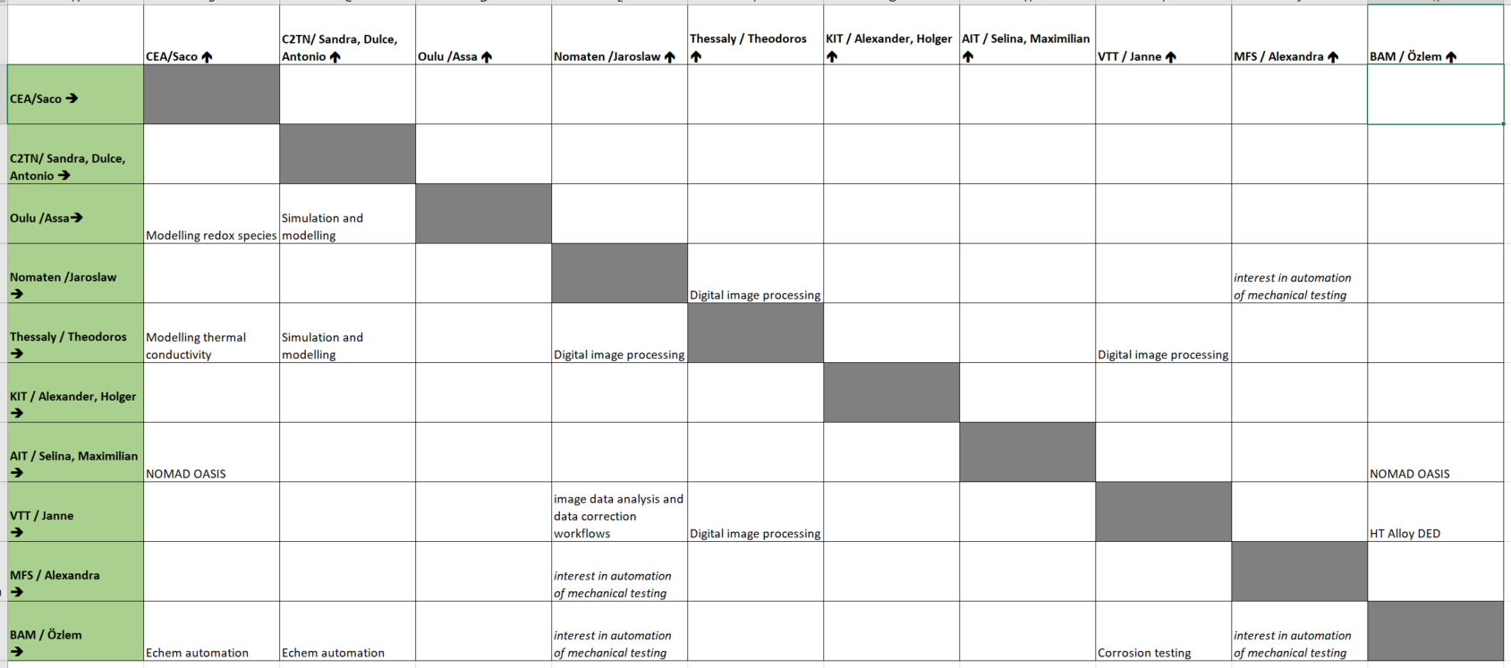
Legacy Labs : interactive match making
➔ STSM visits before September and presentations at Euromat2025 Forum (more details later)

Slide 21
Legacy Labs – next meeting on June 11 & 24
Purpose: matchmaking!
pre-identified matches (top down suggestions)
Grassroot (bottom up agreements)
Format: Online meeting; input shared via dedicated Conceptboard spaces.
https://app.conceptboard.com/board/137k-6ob9-r25a-ikin-d76s
EU-MACE Legacy Lab session March 7th - Google Drive
Invitation email sent to members
Status update:
- Among 16 participants joined the meeting, ~2-3 ‘obvious matches’
- At least 3 discussion on future collaborations have been initiated individually

Slide 22
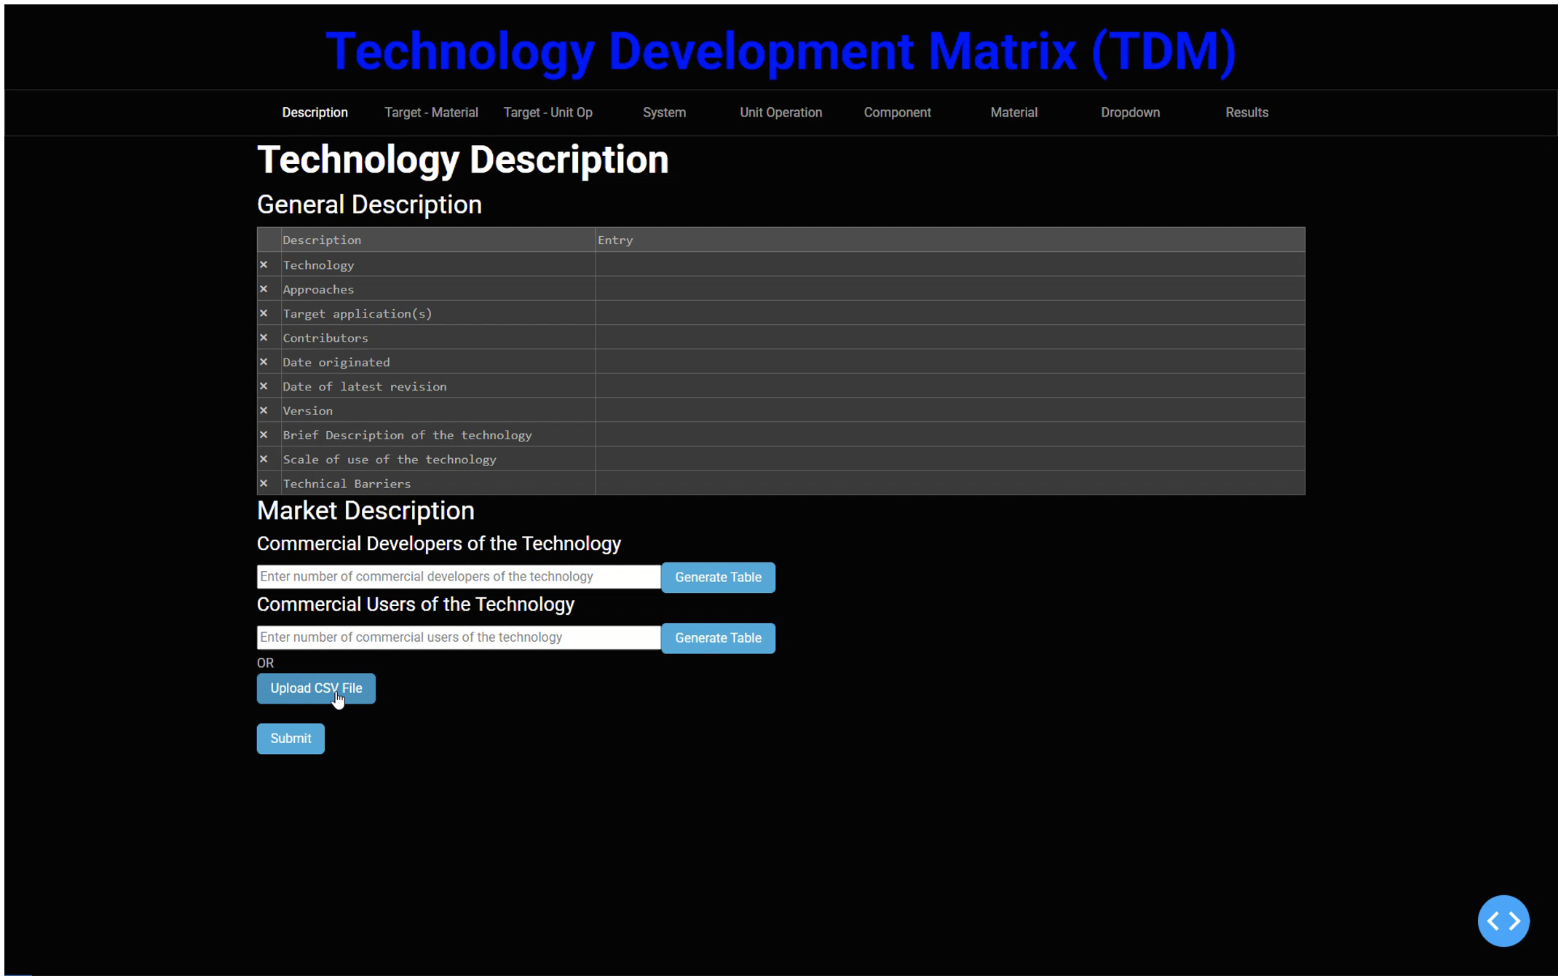
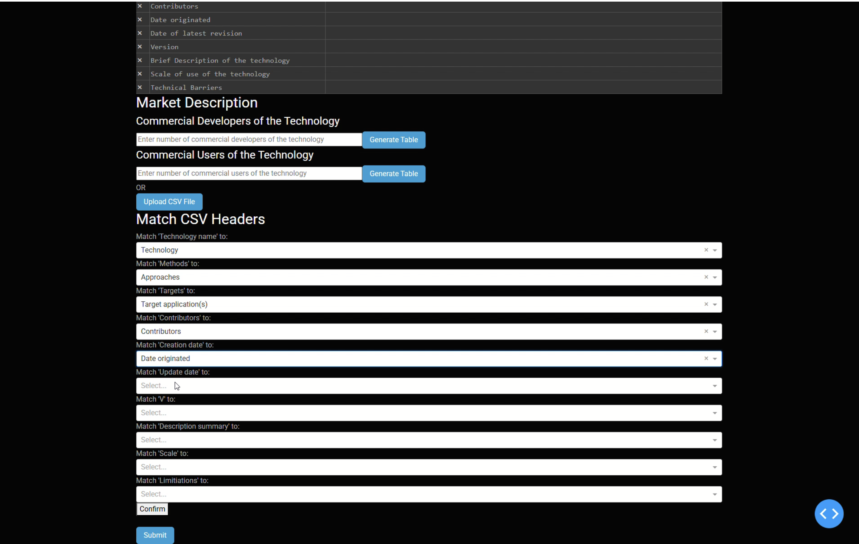
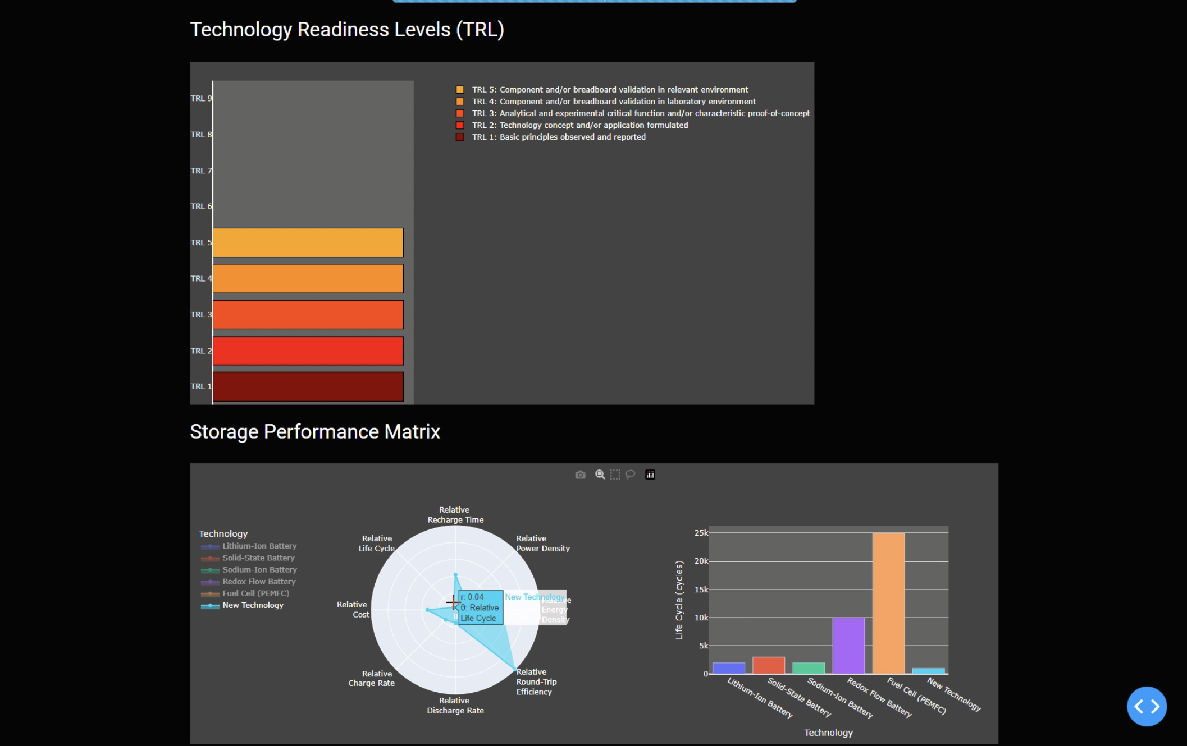
WG-3: TDM follow-up
Targets
Presenting the complete results in EUROMAT2025
Release of white paper (September 2025)
Publication (Dec. 2025)
Status
Semi-Automated data collection, extraction and data entries.
TDM core team
Non-PFAS: Kourosh Malek
nonPFAS-FC: Monica Fabrizio
nonPFAS-WE: Holger Ihssen
MOFs for Energy storage: Dorottya Kriechbaumer
MOF-H2: António Pereira Gonçalves
MOF-CO2: Dave Culliton
Solid Polymer Electrolytes for LiB/NiB and supercaps: Saco Nakamae
SPE-Supercaps: Antonio Peñas Sanjuan & Jorge G. Cañadas
SPE-Battery: Monica Fabrizio
White paper and publications: Iosif Galanakis, Theodore Karakasidis
https://www.nature.com/sdata/journal-impact; https://www.sciencedirect.com/journal/data-in-brief
Next meeting: June 20, 2025
Invitation has been sent to members

Slide 23
Upcoming calls

Slide 24
Horizon EU clusters, EIC, MCSA ….
2026-2027 programme ‘drafts’ are leaking!
Cluster 4 & Cluster 5 are the most pertinent
Contact your university, NCPs, etc.
EIC Accelerator: open and continuous call 2025 submission possible
EIC Pathfinder (open): for Spring next year ➔ brokerage via WGs and Tasks
MCSA: November 25, 2025 ➔ Legacy Lab submission under discussion
➔ Use B2B platform (open for internal use)! Do you want to submit your expertise? Send to Iosif Galanakis <galanakis@upatras.gr>

Slide 25
B2B platform for MAP & Expert list
CHAINMAP Platform update (internal trial version)
Created by Kourosh Malek (DE)
Managed by Iosif Galanakis (EL)
Onboarding presentation recorded
List locked on January 31st (focused on material classes)
Iosif finished « cleaning »
Additional specificiations – equipment, data types/connectivity etc. - to discuss

Slide 26
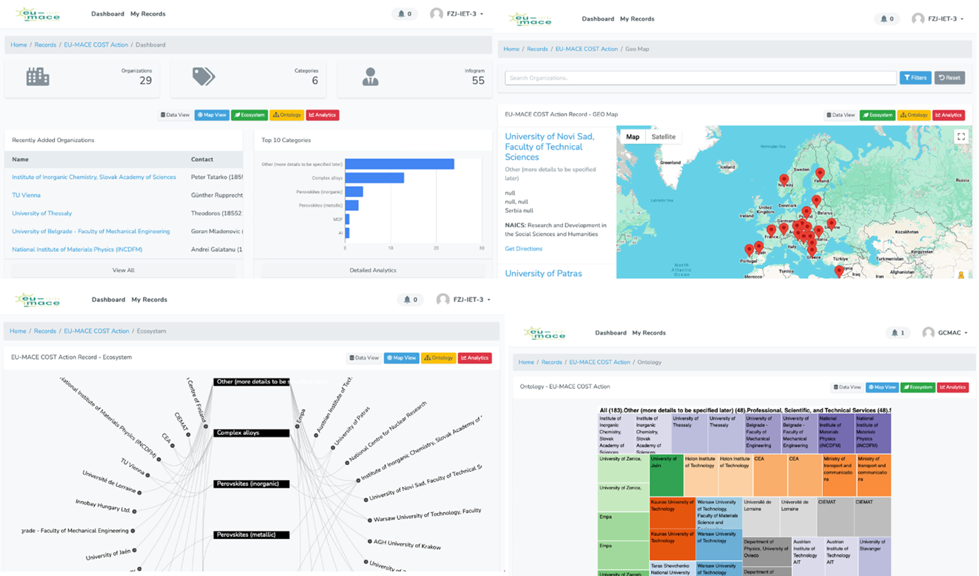
EU-MACE Materials Database – 48 organizations

Slide 27
Next meetings/discussions
Action monthly meeting:
July 8th @ 3pm with Young EU-MACE webminar by S. Mesias – YRI CG recipient (TBC)
September 9th @3pm
TDM: Kourosh k.malek@fz-juelich.de
June 20th (online)
September 14th (@Euromat)
Legacy Labs: Sandra sandrar@ctn.tecnico.ulisboa.pt & Özlem ozlem.ozcan@bam.de
June 11th + 24th (online)
September 14th (@Euromat)
Sustainability: Giampaolo giampaolo.campana@unibo.it
- June 12th – Task leader meeting (online)
Contact WG and Task leaders if you want to participate!

Slide 28
Thank you for your attention !!
Now Tomasz giving our first Young EU-MACE webinar…

Slide 29
Extra slides from previous meeting

Slide 30
Additional details on presentation items
About the online, bi-monthly webinar (Each WG is represented every 6 months)
The webinar should be scientific and rotate among WGs ➔ to be named “coffee with EU-MACE”
YRIs within or outside of Action can be invited
Should further discuss
Who invites and how to choose topics?
Format example: 1 presentation (45”) + discussion (15”)
Industries can also be invited
Topic ideas (should correspond to Action objective: building materials ecosystem/entire value chain)
Science: technical & research challenges in alloys, perovskites … new materials
Gaps: between different stages of value chains
How to accelerate materials research on alloys, perovskites, new materials; e.g., How to incorporate ML into traditional research, step-by-step guide toward automated and autonomous research design.

Slide 31
NEXT STEP: we need volunteers
Expertises
Infrastructure
MAPS List
Expansion
Add Call library?

